Slide 1
Impact of Covid-19 Pandemic on the Global Economy:
Emphasis on Poverty Alleviation and Economic Growth
Presented by Pytorch Project Community
[17th April 2021]

Slide 2


Team - pytorch
Rosemary iwueze
&
Korede Adegboye

Slide 3
Problem Statement
The effect of the pandemic on global economies and social policies remains complex to determine.
This singular action may have impacted economies and their standing.
Unemployment rates across the globe have been questioned due to stringent measures put in place to curb the spread of the virus.
Some believe it has negatively impacted the economy, while others have used it as an opportunity to stimulate economic growth (or poverty alleviation).. Leaving many susceptible to misinformation and uncertainty.
Notes:
Covid-19 has created a dynamic in which it is difficult to determine its impact on the Global Economy
Most are aware that Covid-19 has had some sort of impact on the Global Economy.
National and international leaders need to acquire this account because it gives them an understanding of the pandemic has dynamically altered the Global Economy. We look towards identifying trends and behaviors under uncertainty to give us an account of how we should proceed with poverty alleviation and economic growth.
Our study aims to discover,
Whether or not the Covid-19 pandemic has had a negative or positive impact across the globe. And possibly specific countries.
What are the correlations between deaths or cases and the global economy?
How did the pandemic reduce or increase poverty through population control?
What is the correlation between stringency and the global economy

Slide 4
Data
DATA: This data was gathered from Kaggle.com which had the following features:
Code, Country, Date (Daily – Dec 2019 – Oct 2020), Population,
GDP per capita, Human Development Index
Total Cases, Total deaths, Stringency Index
raw_data – unnamed columns, missing values, “#NUM”
transformed_data – missing values (HDI)
raw_data vs transformed_data – scale and visual
Datatypes – float, int, string (object)
Notes:
GDPCAP - Represents the GDP per Capita offered by a country. GDP is the Gross Domestic Product. It refers to the sum of money that a particular state can use for the welfare of its citizens. GDP per Capita is the division of the GDP among the citizens. Higher the GDP per Capita, more the country is capable of handling pandemic level situations like COVID-19
HDI - Stands for Human Development Index. It is a measure of average achievement in key areas of human development. These could include healthcare facilities, medical advancements etc. Simply put, higher the HDI, better chances of citizens surviving a COVID-19 pandemic.
STI - Refers to how strict governments around the world became during the pandemic. Also refers to how stringent people became about following lockdown rules. In simpler words, it refers to how willing people were to following the rules of a pandemic.

Slide 5
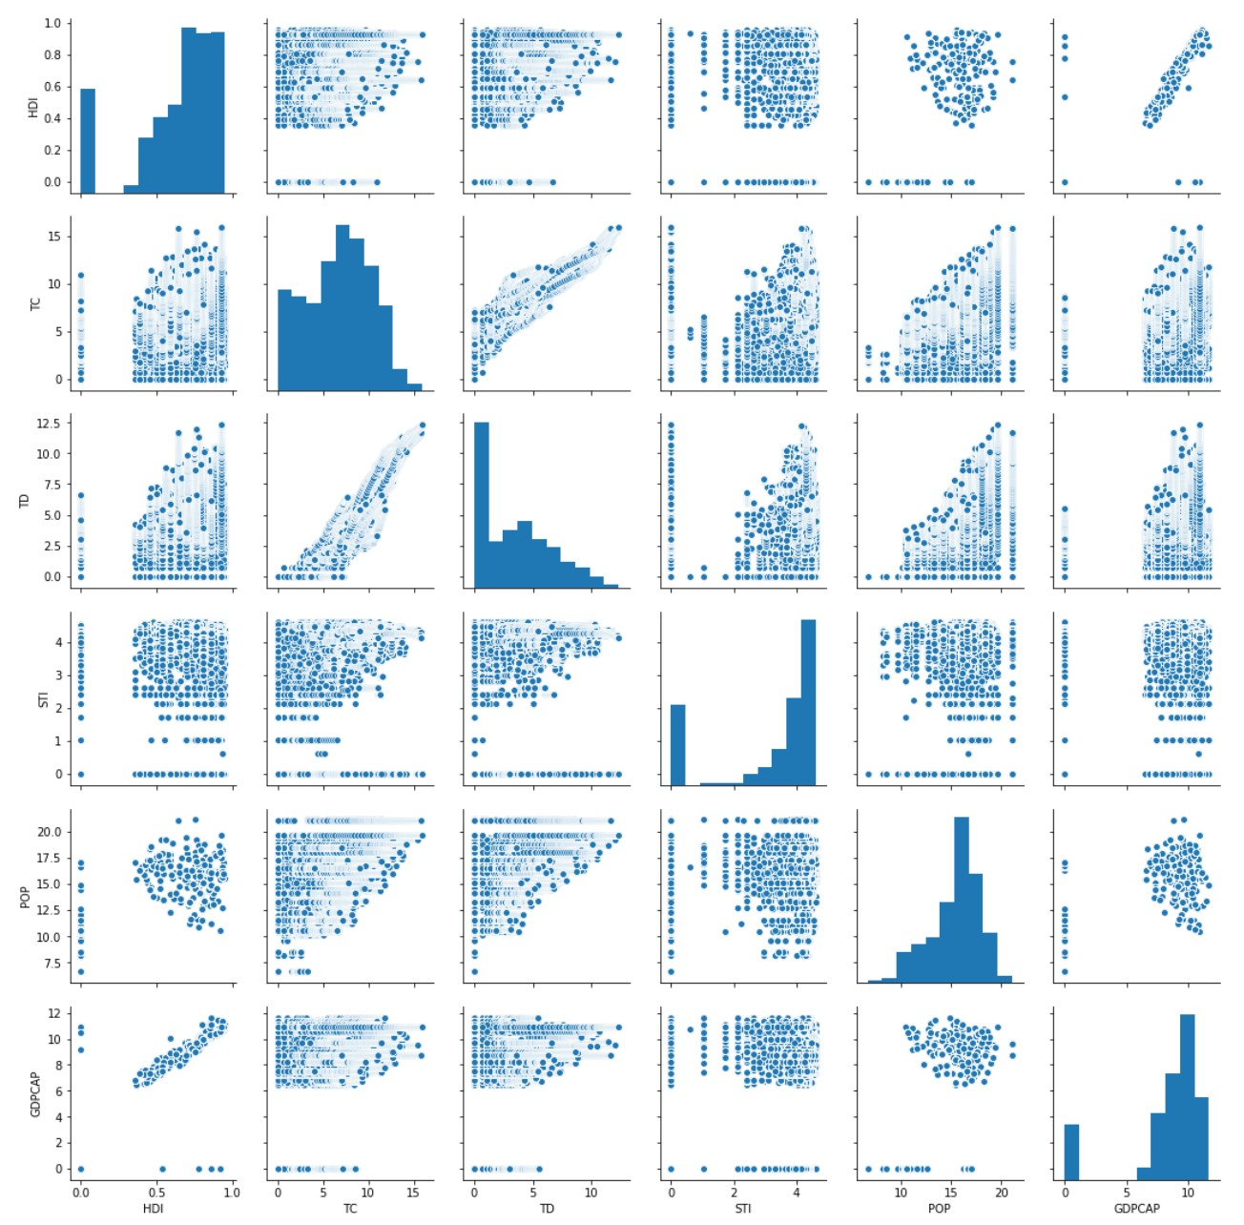
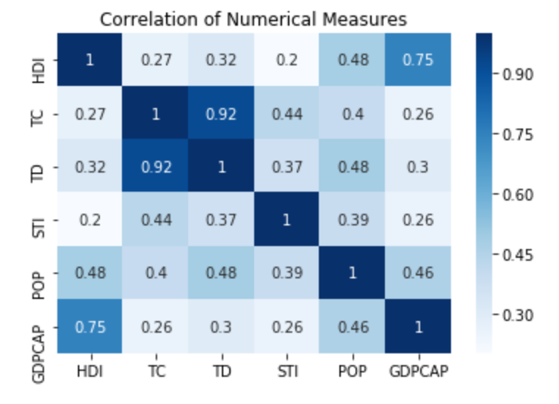
Visualizations
Notes:
Noise when evaluating the distribution of the data because time is disregarded
Low positive correlation between covid-19 features and economic features via visualization and statistical tests
GDPCAP, POP and HDI were constant throughout 2020
Continent data

Slide 6
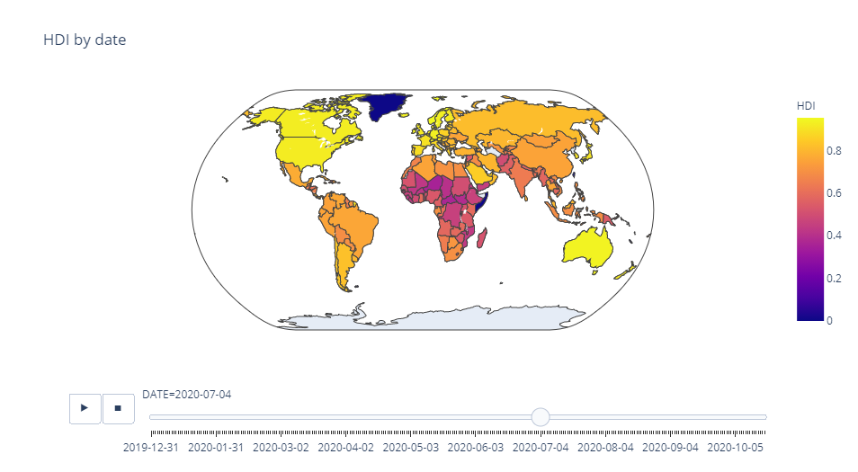
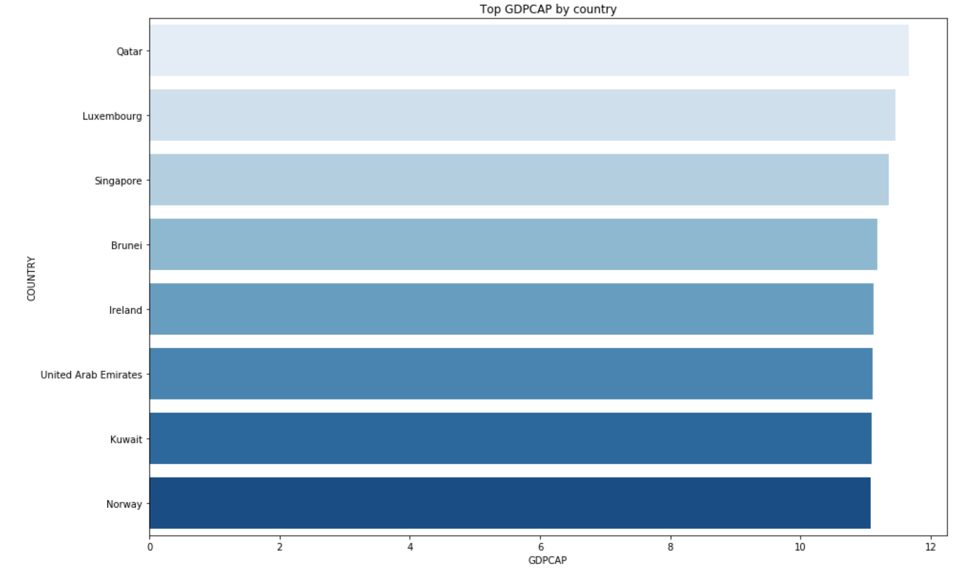
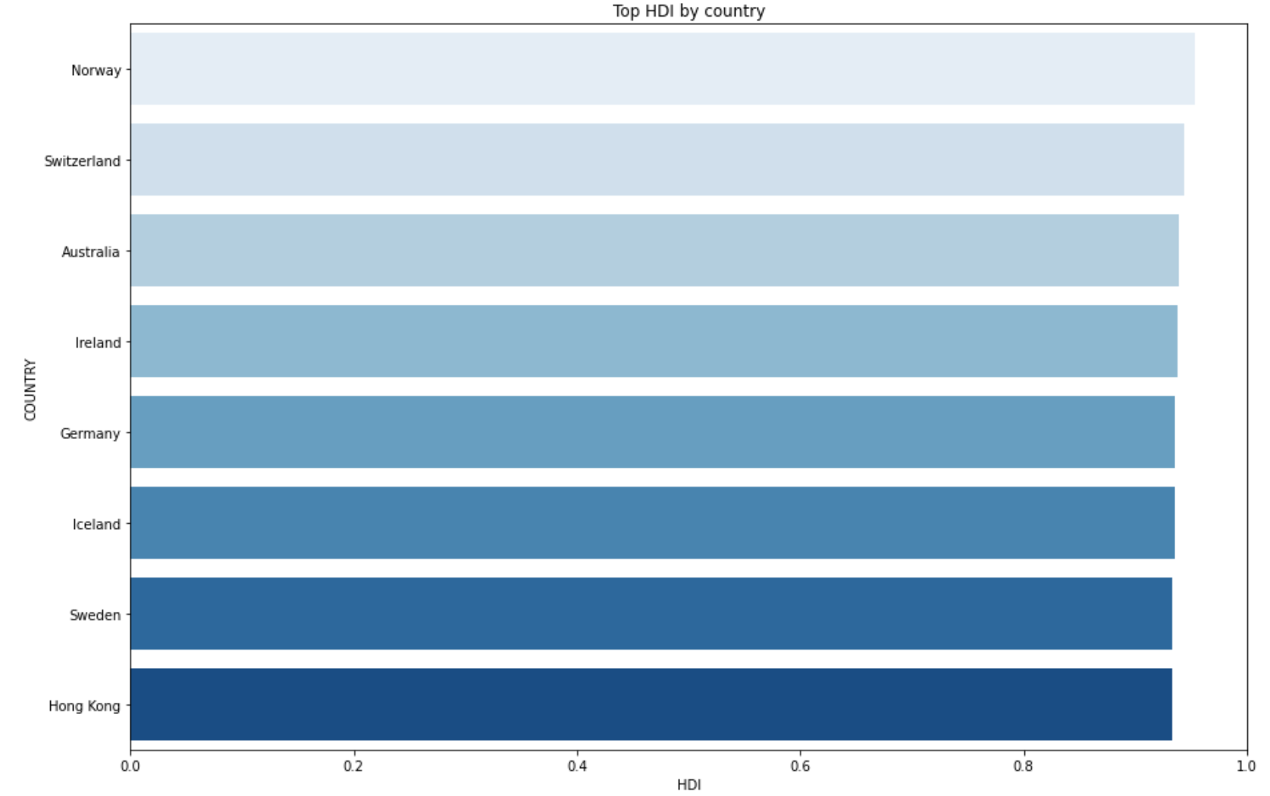

Slide 7
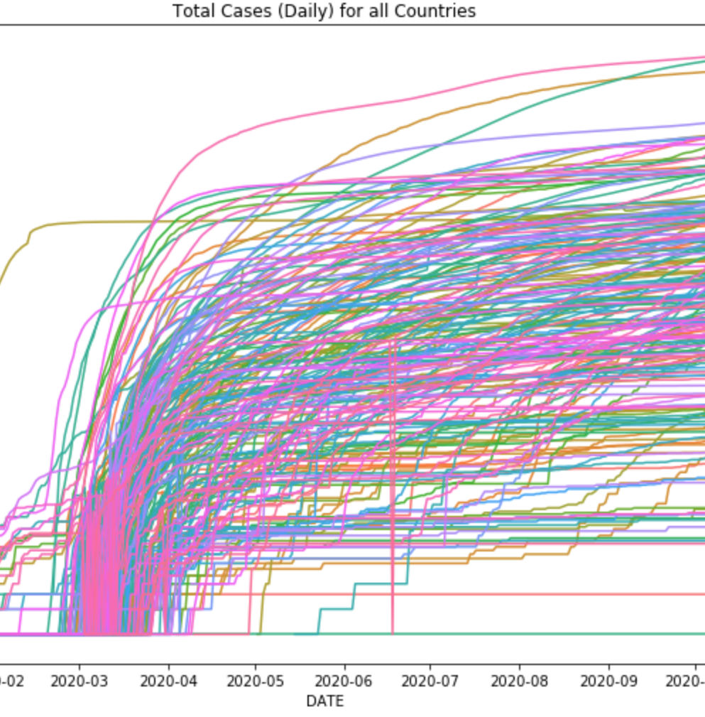
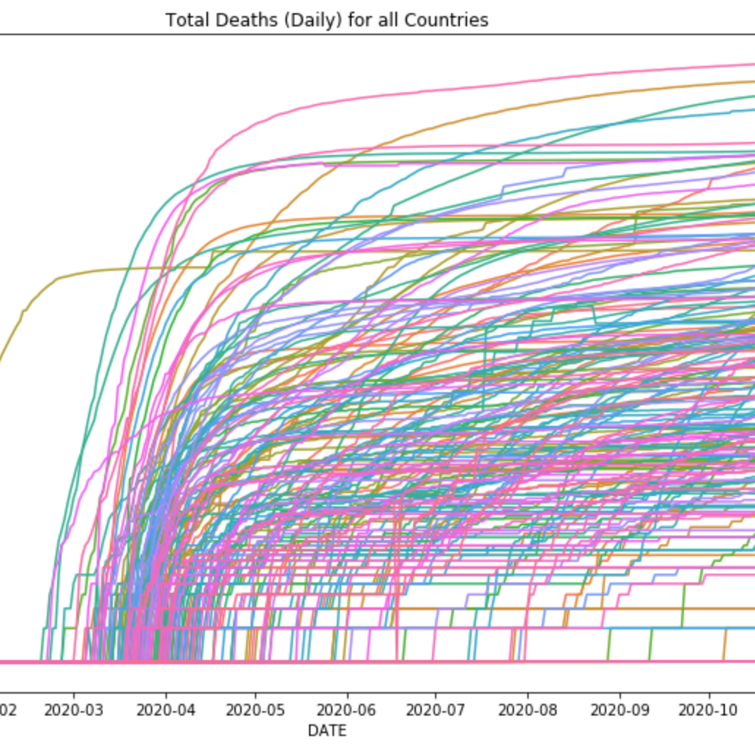
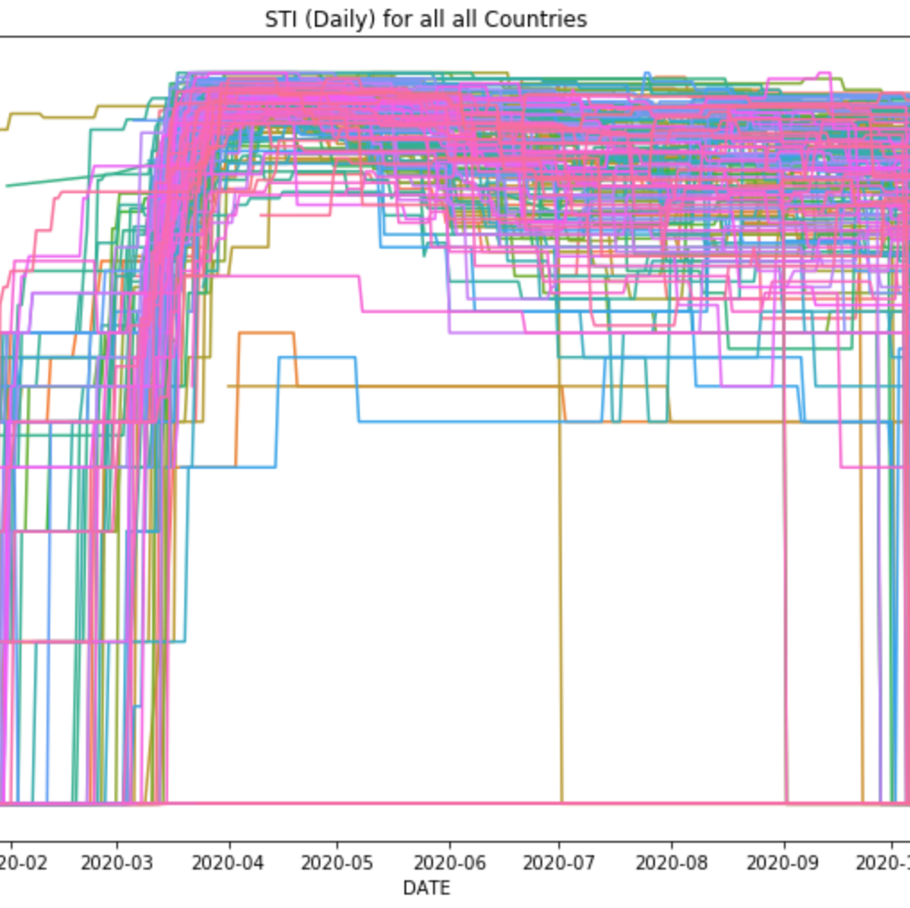

Slide 8
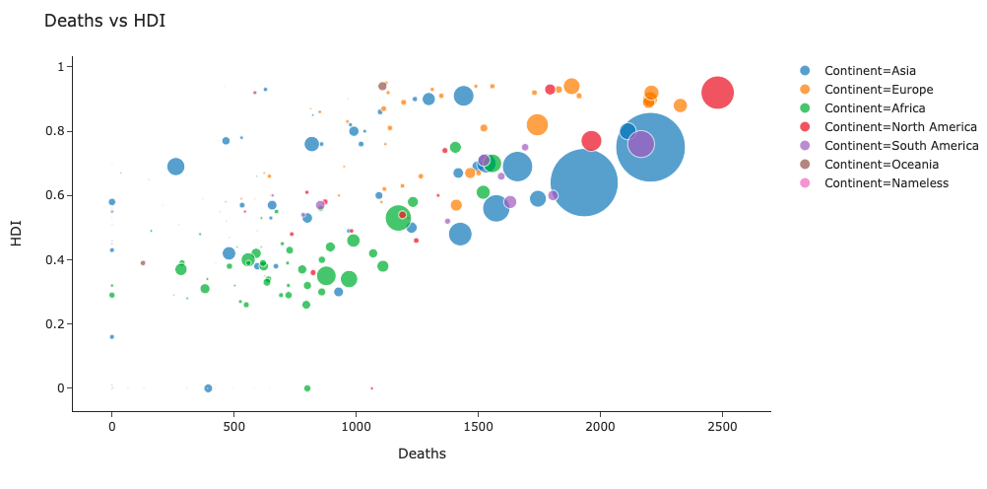
Notes:
Impact on economic growth: Increasing stringency positively supports increasing economic growth where there is an increase in death while at the same time reducing the total confirmed cases.
Impact on economic growth: Increasing stringency positively supports increasing economic growth where there is an increase in death while at the same time reducing the total confirmed cases.

Slide 9
methodology
Dependent variables included the human development index (HDI) and the gross domestic product per capita (GDP) and the independent variables being the stringency index, total confirmed cases and total confirmed deaths.
Multiple Linear Regression
ANN - Multilayer Perceptron
Notes:
We were unable to apply a timeseries model

Slide 10
Model Evaluation
Multiple Linear Regression
MAE = 2.08
R-squared = 0.228
ANN - Multilayer Perceptron
R-squared = 0.119399
Notes:
This study aimed at assessing the effects of the pandemic on global economy, emphasizing on economic growth and poverty alleviation efforts. The data contained 170 countries which had features stringency index, total cases, and total deaths, gross domestic product per capita, human development index.
The study found that the pandemic had a significant impact on economic growth and poverty alleviation. To be specific, it was observed that the stringency measures put in place and the number of cases recorded have an adverse impact on poverty alleviation efforts.

Slide 11
Conclusion
A strong conclusion on the impacts of covid-19 on the global economy cannot be made at this time
Although, we were NOT able to discover a model that explains most of the variance in GDPCAP or HDI, we acknowledge the complexity of this problem.
The models obtained demonstrate the inaccuracy of many, when making decisions regarding the economy
Further analysis
More features
Notes:
This study aimed at assessing the effects of the pandemic on global economy, emphasizing on economic growth and poverty alleviation efforts. The data contained 170 countries which had features stringency index, total cases, and total deaths, gross domestic product per capita, human development index.
The study found that the pandemic had a significant impact on economic growth and poverty alleviation. To be specific, it was observed that the stringency measures put in place and the number of cases recorded have an adverse impact on poverty alleviation efforts. \
To predict future values of GDPCAP or HDI, we will need to obtain historical data

Slide 12
Thank You!

Slide 13

Questions

